Slide 1
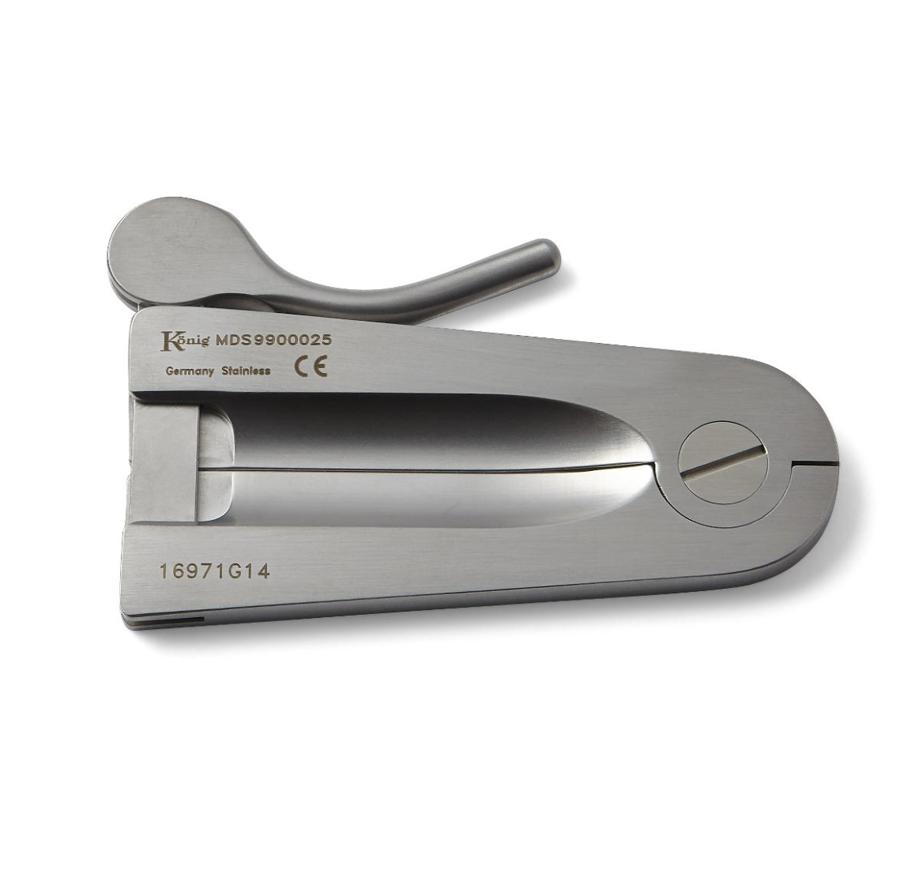
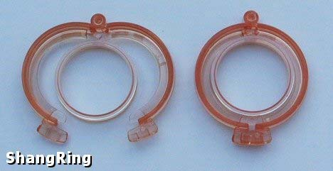
SAFETY OF EARLY INFANT MALE CIRCUMCISION (EIMC) IN A TRIAL OF THE SHANG RING VS MOGEN CLAMP IN RAKAI, UGANDA.
Stephen Kiboneka¹, Aggrey Anok¹, Edward Kankaka¹, Ronald Kusolo¹, Regina Nakabuye¹, Kasule Jingo¹, Fred Nalugoda¹, Quentin Awori ^{4,7}, Dan Ouma⁴, Alice Christensen ^{5,6}, Omar Al Hussein Alawamlh², Mark Barone⁴, Marc Goldstein², Alvin Mushlin², Jason Reed⁵, Cindy Liu⁸, Jon Greenwood⁸, Ronald H Gray^{1,3}, Maria Wawer ^{1,3}, Phillip Li², Richard Lee², Joseph Kagaayi¹ ,Godfrey Kigozi¹
¹Rakai Health Sciences Program, Kalisizo, Uganda, ²Weill Cornell Medical College, New York, NY 10065, USA, ³Johns Hopkins Bloomberg School of Public Health, Baltimore, Maryland, ⁴ Population Council, 1230 York Avenue, ⁵ Jhpiego, Baltimore, MD 21231, ⁶ Iringa Regional Referral Hospital, Iringa, Tanzania, ⁷ Homa Bay County Teaching and Referral Hospital, Homa Bay, Kenya, ⁸ George Washington University, Washington, DC 20052, USA,⁹ GBH Insights, LLC, New York, NY 10016.
Correspondence: skiboneka@rhsp.org OR kstephendalton@gmail.com
Background
Methods
Circumcision reduces male HIV acquisition by up to 60%.
EIMC has several advantages over adult and adolescent circumcision:
Cheaper,
No risk of an early resumption of sex,
Faster wound healing, etcetera
In this randomized trial, we compared:
The safety of the ShangRing device with the Mogen Clamp, and
Maternal satisfaction with the appearance of the infant’s healed penis.
Participants: 460 infants aged 0-60 days
Study Period: September 2018 to September 2019
Randomization: Mogen to ShangRing ratio = 1:1
Analgesia/Anesthesia: Topical EMLA cream and rectal paracetamol
Circumcisers: Trained clinical officers or registered nurses/midwives (no difference in previous study
Follow-up: weekly up to day 42 or until complete wound healing.
Endpoints:
Safety
Adverse events
Healing time (clean intact circumcision wound)
Maternal satisfaction
Cosmetic appearance
Analysis:
Chi-square or Fisher exact tests for categorical outcomes
Mann-Whitney test for medians (IQR) for continuous outcomes
Student t-test for difference in group means
Results
Baseline Characteristics
Safety and Maternal Satisfaction
SHANGRING
MOGEN CLAMP
 | ShangRing | Mogen | p-value
Age in days Mean(SD) Median(IQR | 32.91(16.1) 34(19-46) | 32.40(16.0) 33(19-46) | 0.732 0.716
Weight in kg Mean(SD) Median(IQR) | 4.32(0.82) 4.3(3.7-4.8) | 4.34(0.84) 4.3(3.8-5.0) | 0.820 0.604
Recruitment site, n(%) Kakuuto HC IV Kalisizo Hospital Lyantonde Hospital Masaka Referral Hospital Rakai Hospital | 56(24.4) 31(13.5) 26(11.3) 57(24.8) 60(26.1) | 43(18.7) 36(15.7) 29(12.6) 70(30.4) 52(22.6) | 0.387
Parent’s Education, n(%) None Primary Secondary Tertiary | 6(2.6) 99(43.2) 101(44.1) 23(10.0) | 6(2.6) 89(38.7) 98(42.6) 37(16.1) | 0.279
 | ShangRing | Mogen | p-value
Adverse events n(%) Mild Moderate | 8(80.0) 2(20.0) | 22(84.6) 4(15.4) | 1.000
Healing time in days Mean (SD) Median (IQR) | 18.93(5.98) 15(14-21) | 18.30(5.54) 15(14-21) | 0.241
Maternal satisfaction, n(%) Unsatisfied Somewhat satisfied Satisfied | 1(0.4) 17(7.5) 210(92.1) | 0(0.0) 5(2.2) 223(97.8) | 0.009
Device
Day 14
result
Conclusion
The ShangRing device has comparable safety and wound healing time to the Mogen clamp but relatively lower maternal satisfaction.
PRESENTED AT THE 23RD INTERNATIONAL AIDS CONFERENCE (AIDS 2020) | 6-10 JULY 2020

